Slide 1

Family Social Network
Jadara University
Faculty of Science and Information Technology
Done By:
XXXXXXXXXXXXXX
Supervisor
Dr. S….

Slide 2
Family Social Network
App Android that helps Families to:-
Increase communication between members family.
to Organize family matters.
A platform for displaying family matters.
Support Arabic language for Arabic users.

Slide 3
Problem Statement
On public social networking sites like Facebook we share our day to day activities with our friends and acquaintances, but where do we share our intimate family moments? Is it time to go for a private social network.

Slide 4
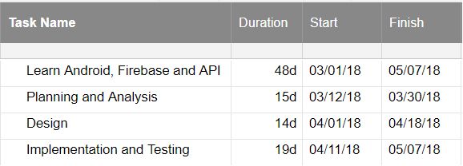
Gantt Chart

Slide 5
Related work
# | Family Crossings | eFamily | FamilyWall | JustFamily | 23Snaps | MyFamily
Services with advantage | Posts, share address, and files, post to family forums and provides rules e.g. table manners | Posts, family tree, Home Needs and stories section | Posts, calendar, private messaging and help parents follow wandering teenagers on map | share photos with family | share photos with family and connected with Instagram | retired now
disadvantage | Free accounts only 250 MB, standard $19.95/year for 350 MB and premium versions $9.95/month for 500 MB. | design is fairly outdated |  | Only share photos and limit space (1GB) for free | Only share photos | retired now

Slide 6
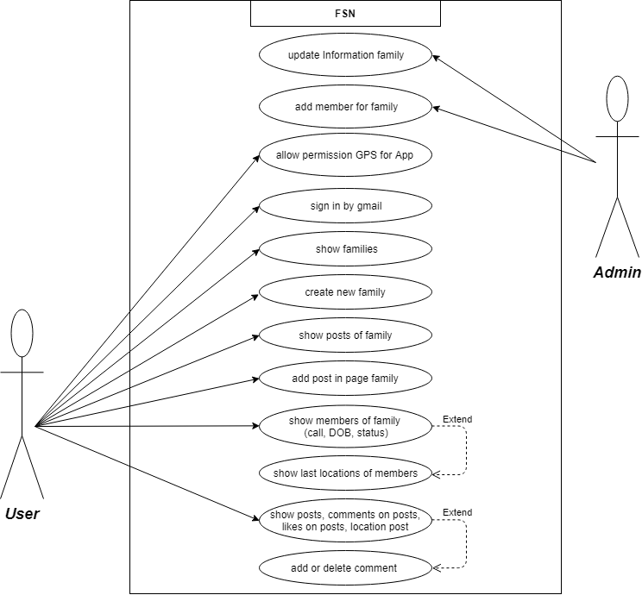
Use Case Diagram

Slide 7
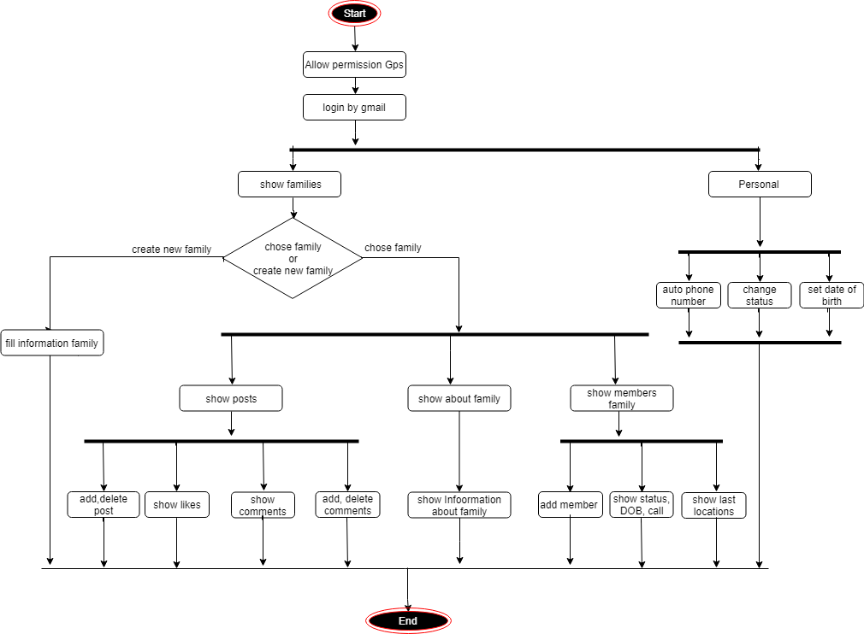
Activity Diagram

Slide 8
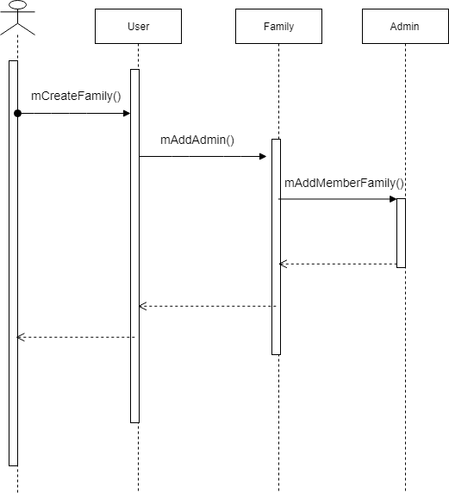
Sequence Diagram for How Create Family ?

Slide 9
Future Work
In the near future, complete all requirements and add functionalities will be added to this system, these functions will be like:
Improved application design.
Show list likers of post.
Authentication mobile number.
Add post only text.
Put a box for renewed information important things in about family

Slide 10
what learned from graduation project ?
Ability to learn any modern technology.
Big experience in Android and familiar in Java.
Learned several Concepts in API , Google API , NoSQL and Firebase.
Ability to organize time.

Slide 11
Thank You

